Slide 1
Segmentation of Skin Lesions Using Combined Adaptive Thresholding and Connected Component Analysis
Johnathan Maynard (jam945)
Aswin Raghav Nirmaleswaran (an539)
Stephen Schneider (sms675)

Slide 2
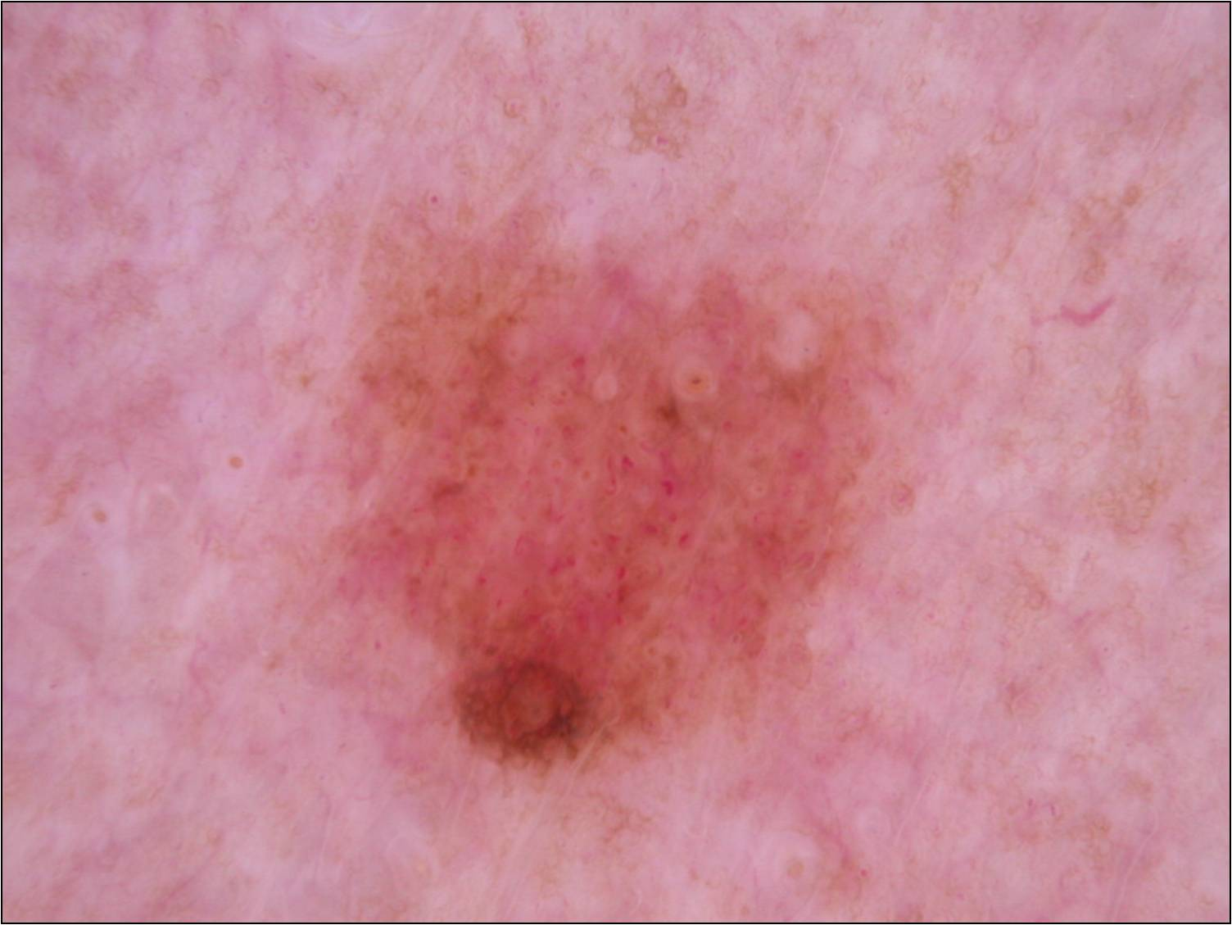
Problem
Malignant melanoma, is a type of cancer that develops from the pigment-containing cells known as melanocytes.
For surgery or radiotherapy, exact identification of cancerous regions is necessary.
Identification and categorization of skin lesions is typically performed by dermatologists
The process is both tedious and time consuming
Dermoscopy of malignant melanoma
Celebi, M., Wen, Q., Iyatomi, H., Shimizu, K., Zhou, H., & Schaefer, G. (2015). A State-of-the-Art Survey on Lesion Border Detection in Dermoscopy Images. Dermoscopy Image Analysis, 97-129. http://dx.doi.org/10.1201/b19107-5

Slide 3
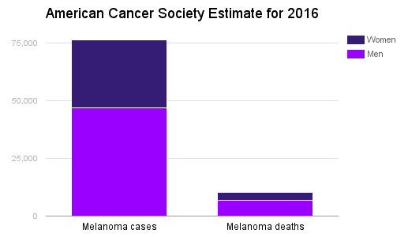
Significance
Misdiagnosis or insufficient diagnosis can lead to...
Patient anxiety
Unnecessary procedures
Incomplete removal
There is a clear need for robust segmentation algorithms to automatically determine the extent of skin lesions
Cancer.org- Key Statistics for melanoma skin cancer: http://www.cancer.org/cancer/skincancer-melanoma/detailedguide/melanoma-skin-cancer-key-statistics, 20th May, 2016
http://www.cancer.org/myacs/eastern/areahighlights/cancernynj-news-new-york-tanning-troubles

Slide 4
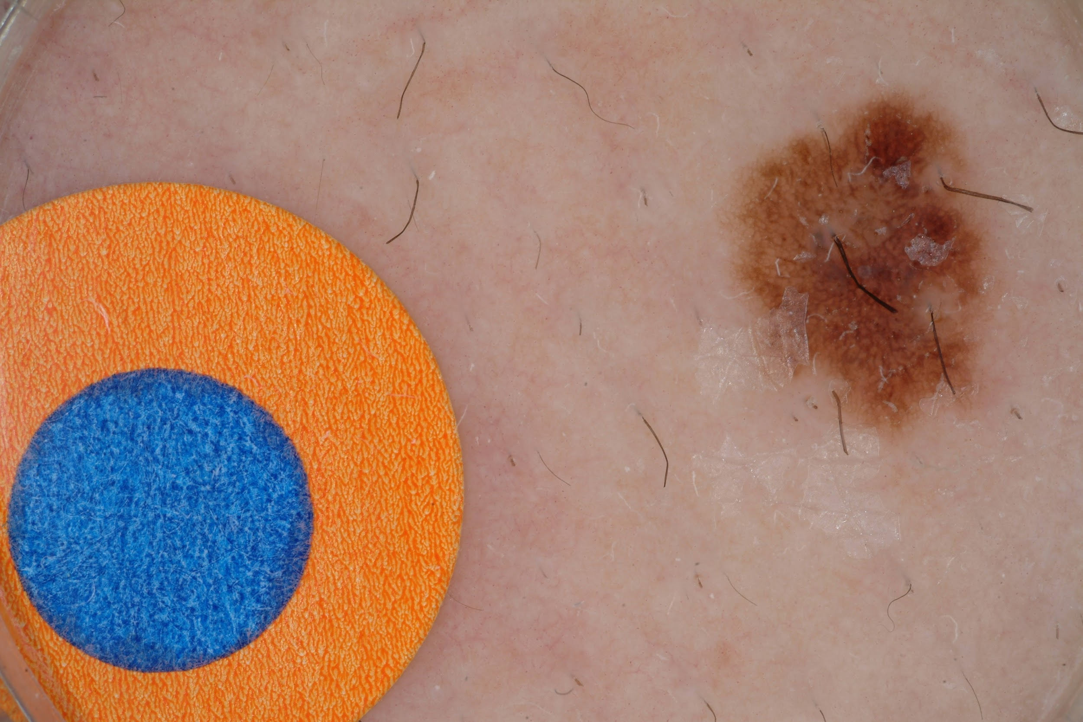
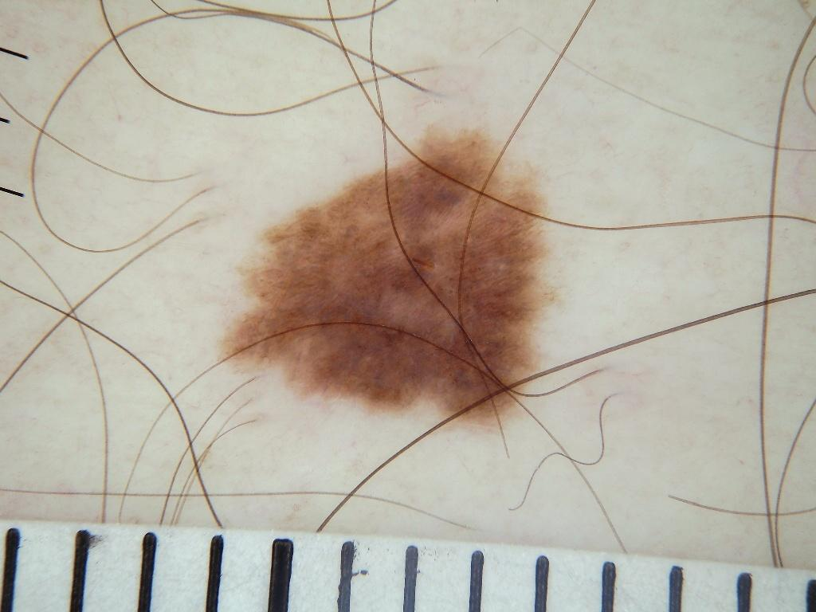
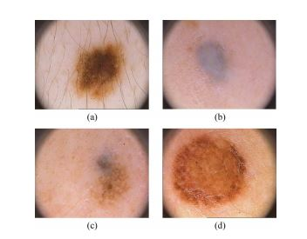
Hindrance to Robustness
Hair is often detected as an edge.
Low contrast between skin and lesion makes segmentation difficult.
Artifacts in the image
Stickers
Dark Regions
Lines
Image resolution variation
Margarida Silveira, Jacinto C. Nascimento, Jorge S. Marques, André R. S. Marçal, Teresa Mendonça, Syogo Yamauchi, Junji Maeda, and Jorge Rozeira “Comparison of Segmentation Methods for Melanoma Diagnosis in Dermoscopy Images”, IEEE JOURNAL OF SELECTED TOPICS IN SIGNAL PROCESSING, VOL. 3, NO. 1, FEBRUARY 2009.

Slide 5
Prior Art
Ma et al. 2016:
- Deformable Model based
- Median Filter Pre-processing
- Uses all three color channels
- Interoperates between channels for region growing
- Robust
- Outperformed Wong et al., GVF, snakes, and color clustering
References:
J. Nascimento and J. S. Marques, “Adaptive snakes using the em algorithm,” IEEE Trans. Image Process., vol. 14, pp. 1678–1686, 2005.
Y. Q. Chen, M. S. Nixon, and D. W. Thomas, “Statistical geometrical features for texture classification,” Pattern Recognit., vol. 28, no. 4, pp. 537–552, 1995.
Zhen Ma and Joao Manuel R. S. Tavares, “A Novel Approach to Segment Skin Lesions in Dermoscopic Images Based on a Deformable Model”, IEEE JOURNAL OF BIOMEDICAL AND HEALTH INFORMATICS, VOL. 20, NO. 2, MARCH 2016.
A. Wong, J. Scharcanski, P. Fieguth. Automatic skin lesion segmentation via iterative stochastic region merging. IEEE Transactions on Information Technology in Biomedicine, 15(2011),pp.929-936
Nascimento et al. 2015:
Adaptive Snake
Estimation-Maximization
Maximum a posteriori criterion
Iterative
Wong et al. 2011:
Iterative stochastic region growing
Stochastic: Markov Random Fields
Local spatial interactions and densities
Outperformed GVF and level set active contours

Slide 6
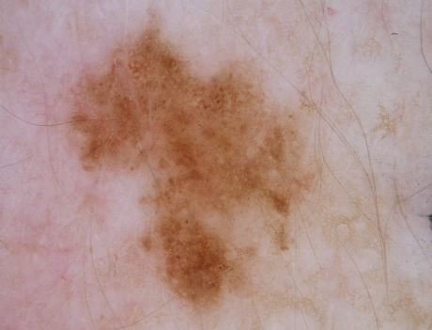
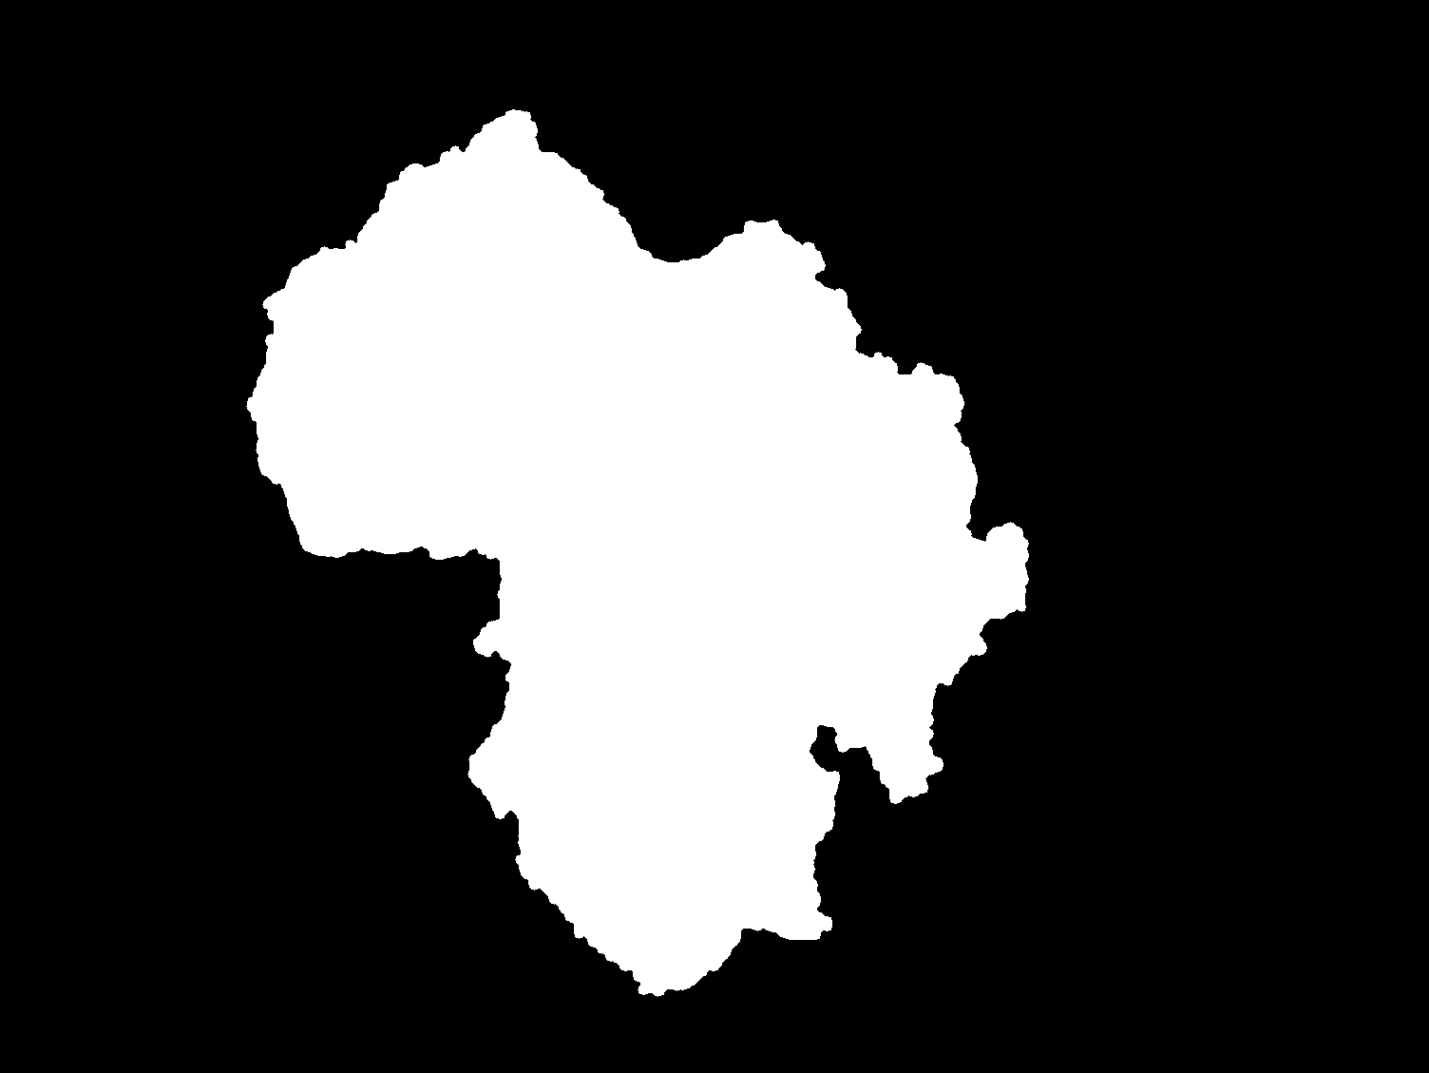
Experiment
Dataset
2016 ISBI Skin Lesion Analysis Towards Melanoma Detection Challenge
RGB color dermoscopic image
Ground truth manually drawn by dermatologists
900 images and corresponding ground truths
Training
25 randomly selected images
Testing
100 different randomly selected images

Slide 7
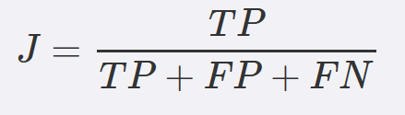
Experiment Continued
Documentation
Parameters and values
Ground truth mask
Automatically generated mask
Jaccard index
Used to rank team algorithm effectiveness
Highest ranking team achieved and average index of 0.843
Training
Optimize parameters for highest average Jaccard index
Testing
Use optimized algorithm to generate automatic masks and record the average Jaccard index
0 ≤ J ≤ 1
Hypothesis: By combining adaptive thresholding and connected component analysis, a Jaccard index of at least 0.843 will be achieved across the test image set.

Slide 8
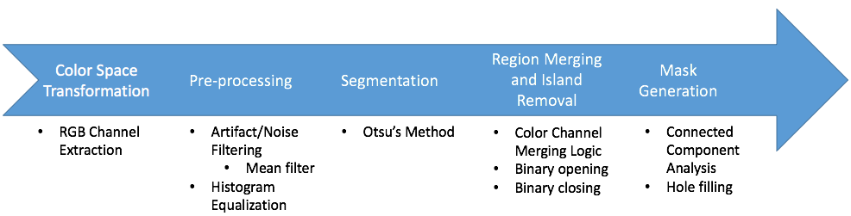
Proposed Algorithm

Slide 9
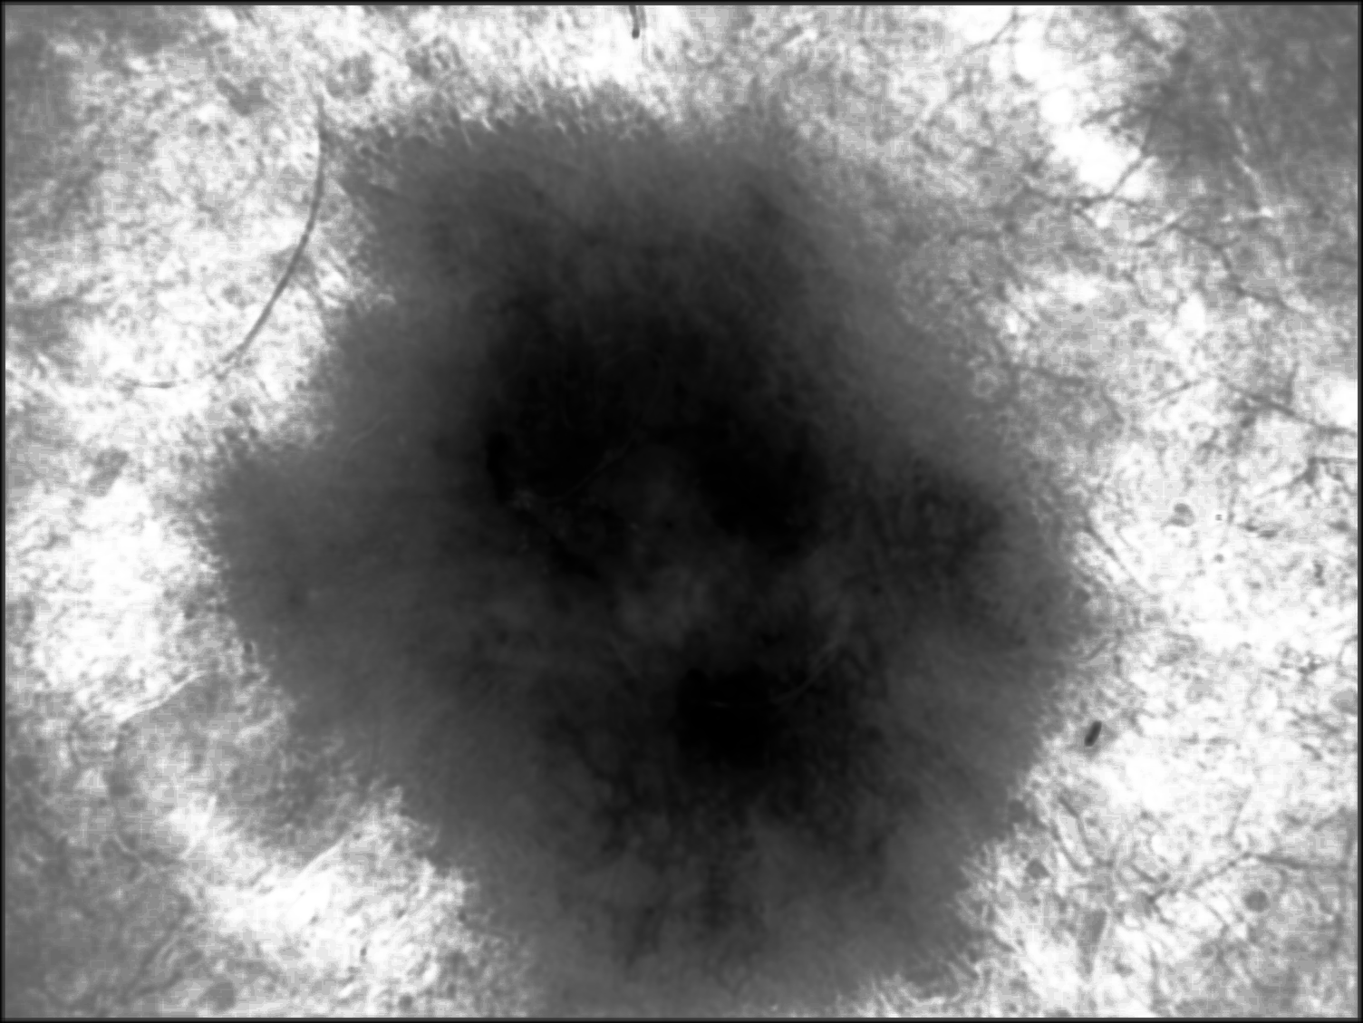
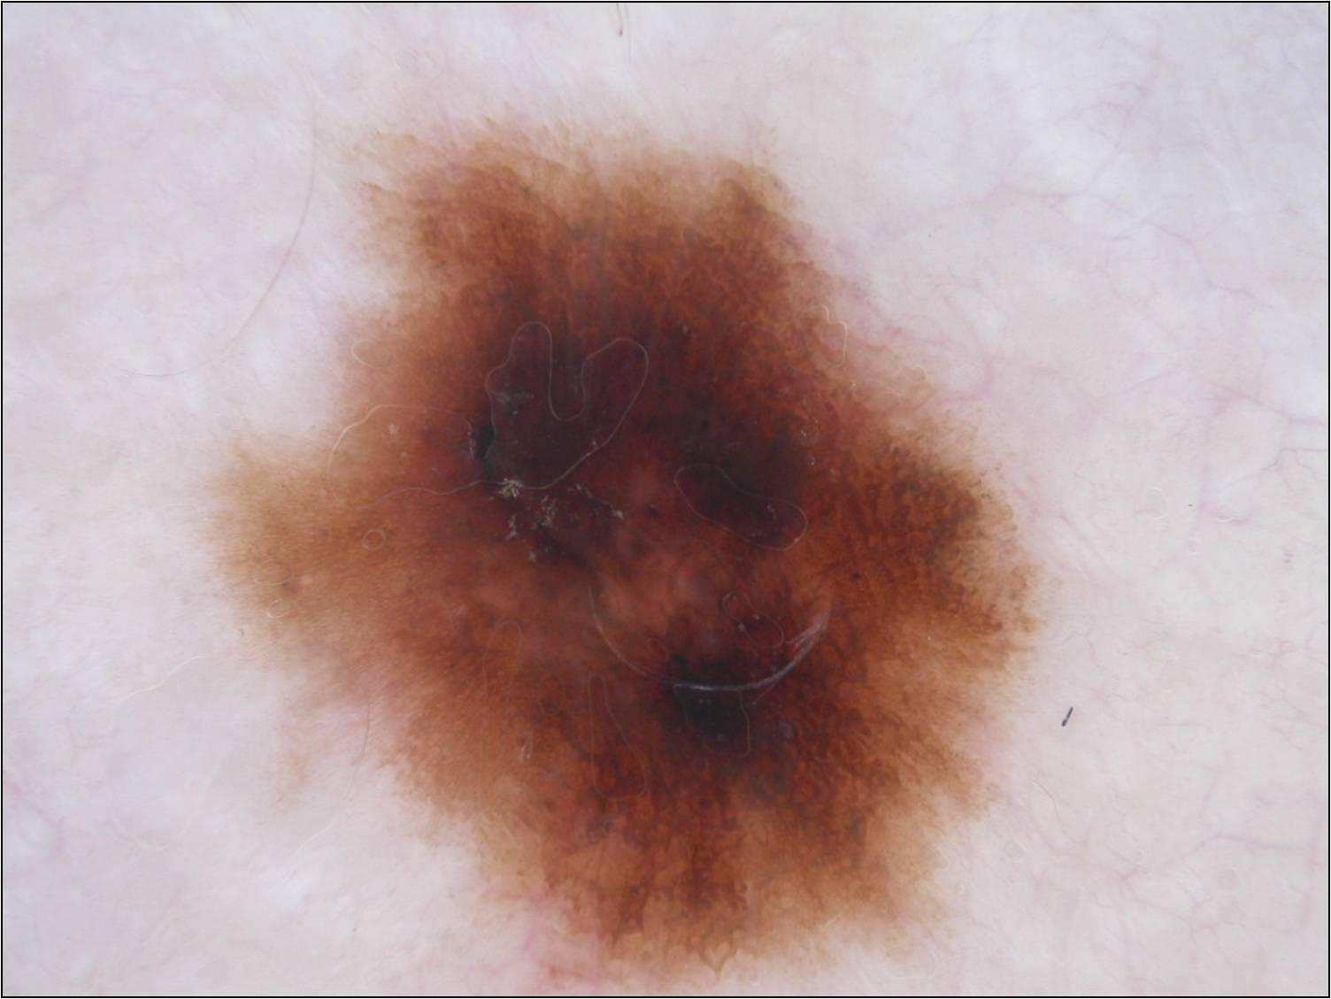
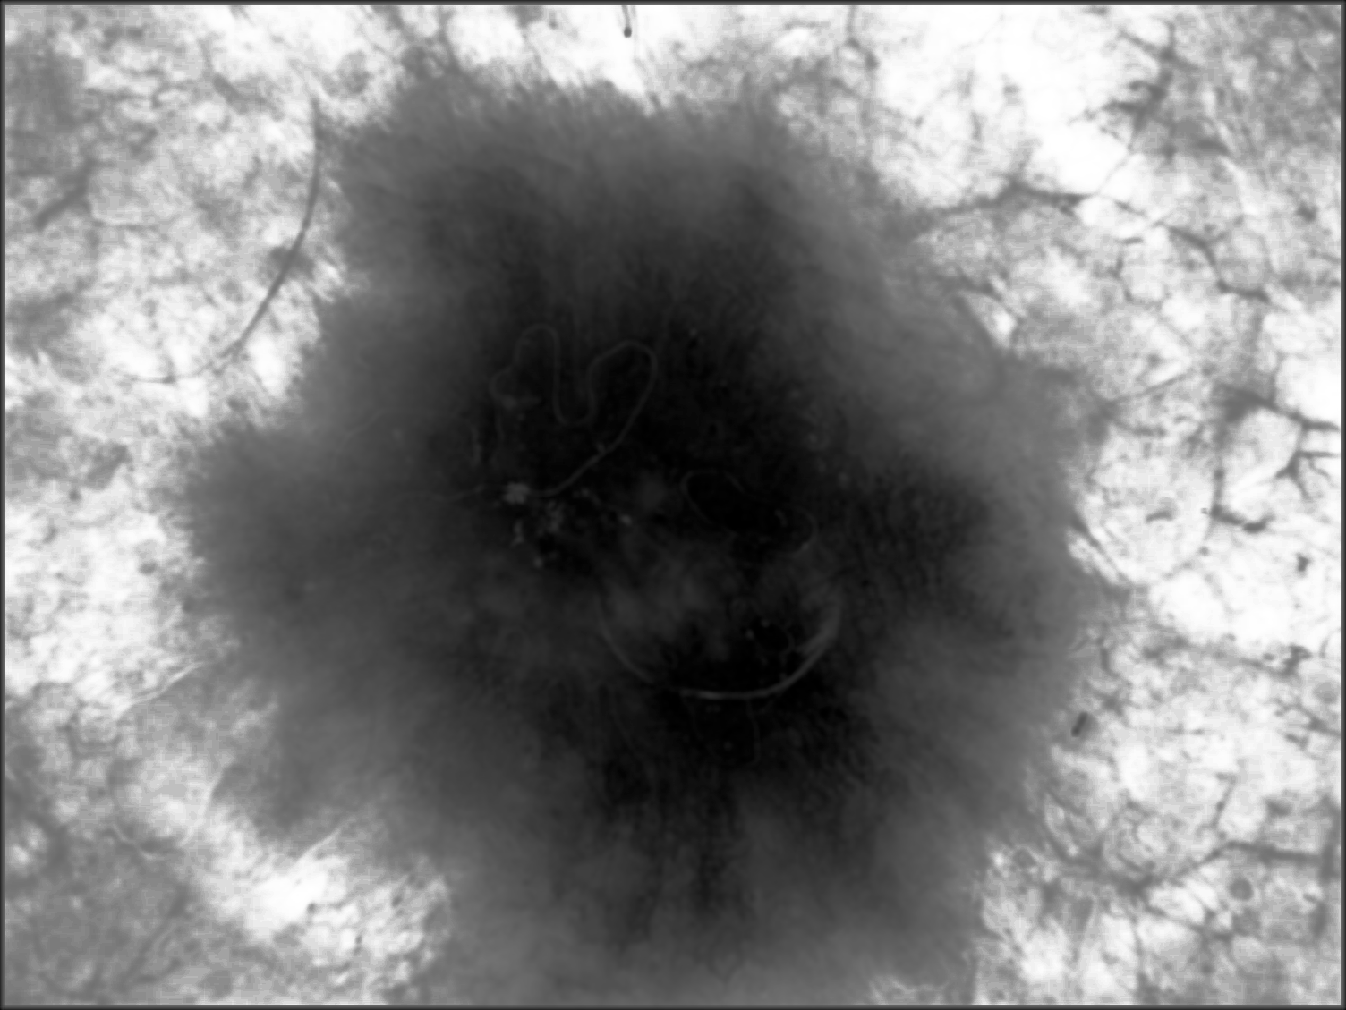
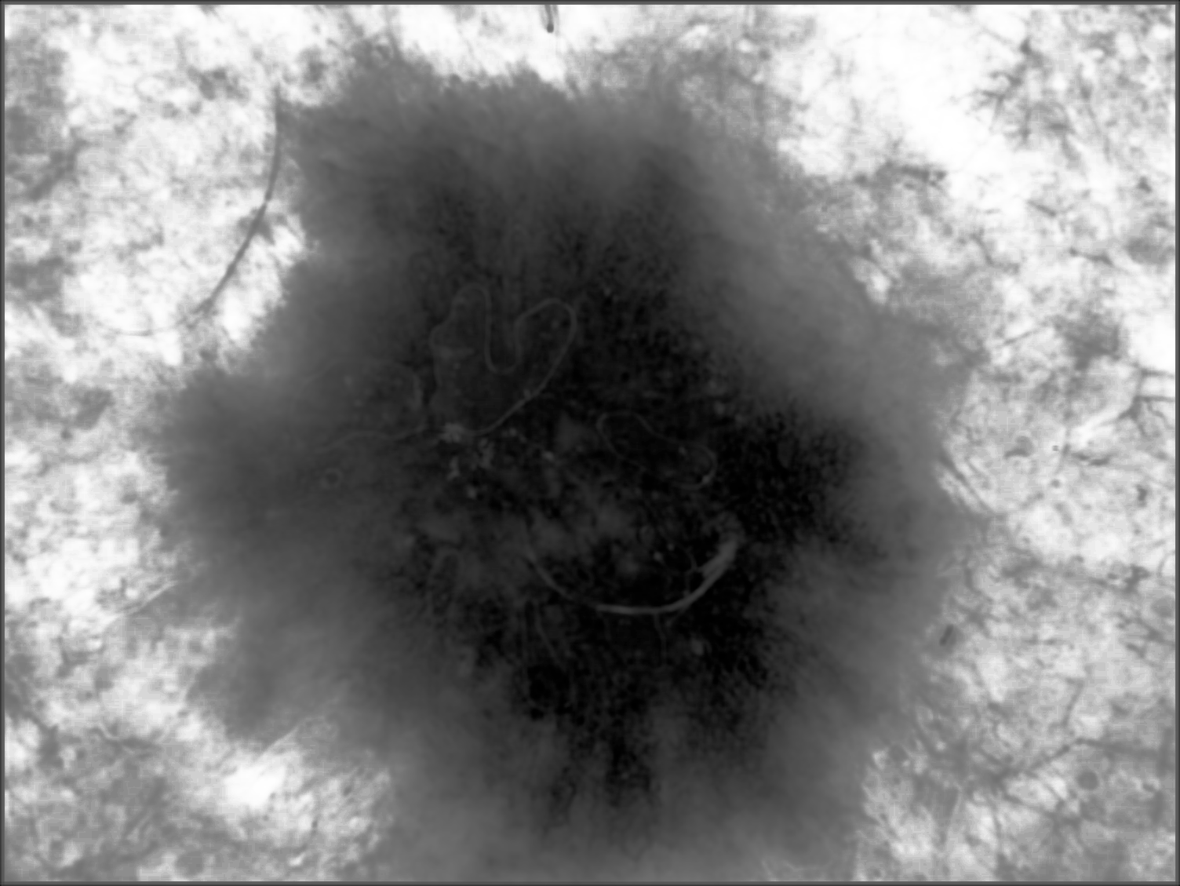
Algorithm Flow
R
Mean Filter & Equalization
Otsu’s Method
G
B
Artifact removal and filtering
RGB Channel Extraction
Adaptive thresholding
Input Image
Notes:
Final algorithm
Mean filter (7x7) - In the future make the filter size scaled to image size
Morphological opening (r=30)
Morphological closing (r=70)
Connected Component Analysis
Hole filling

Slide 10
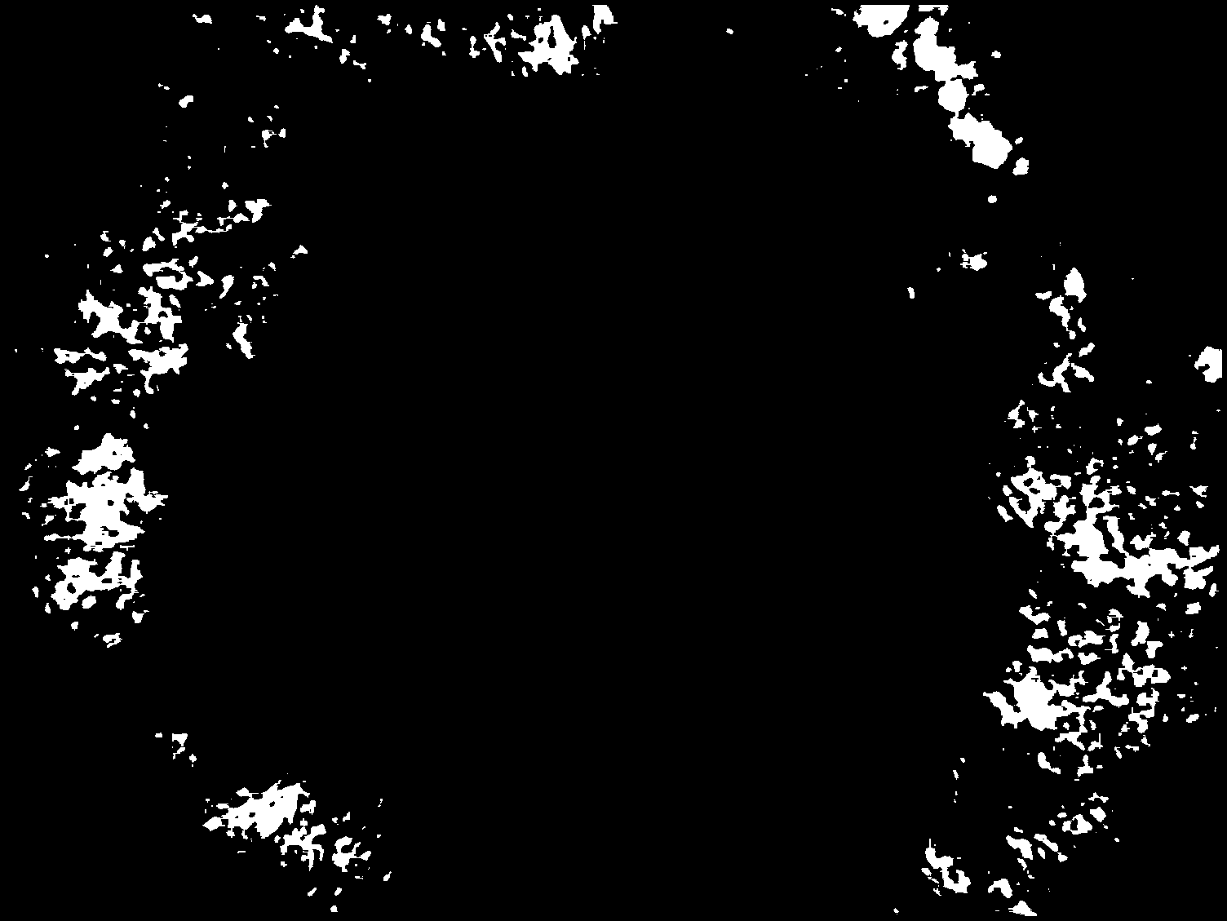
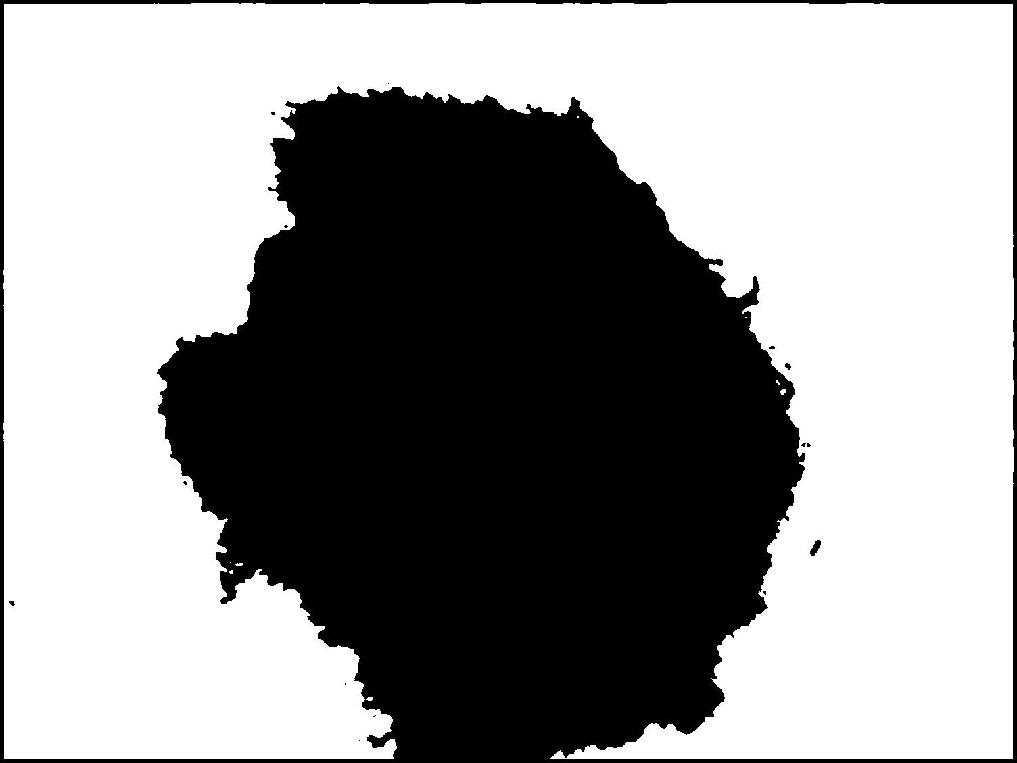
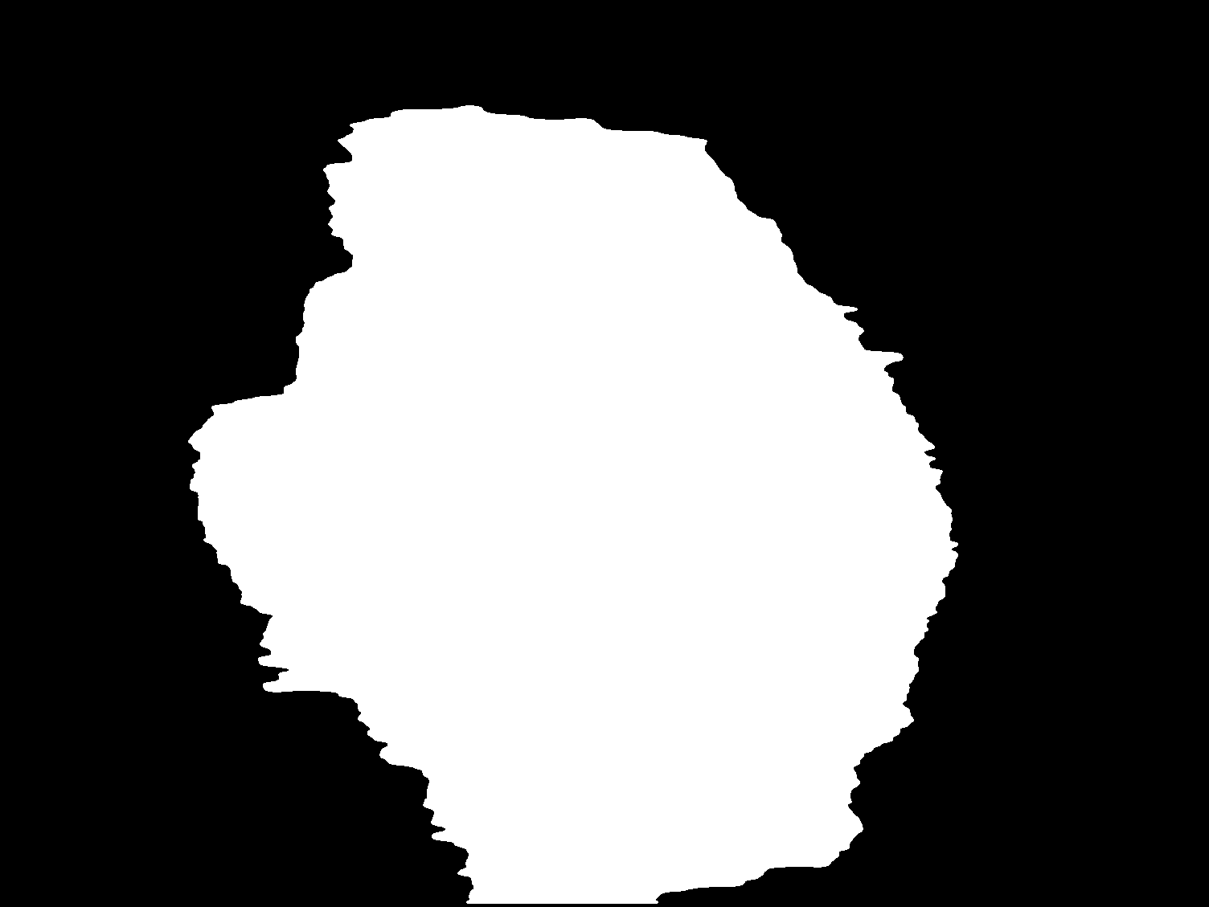
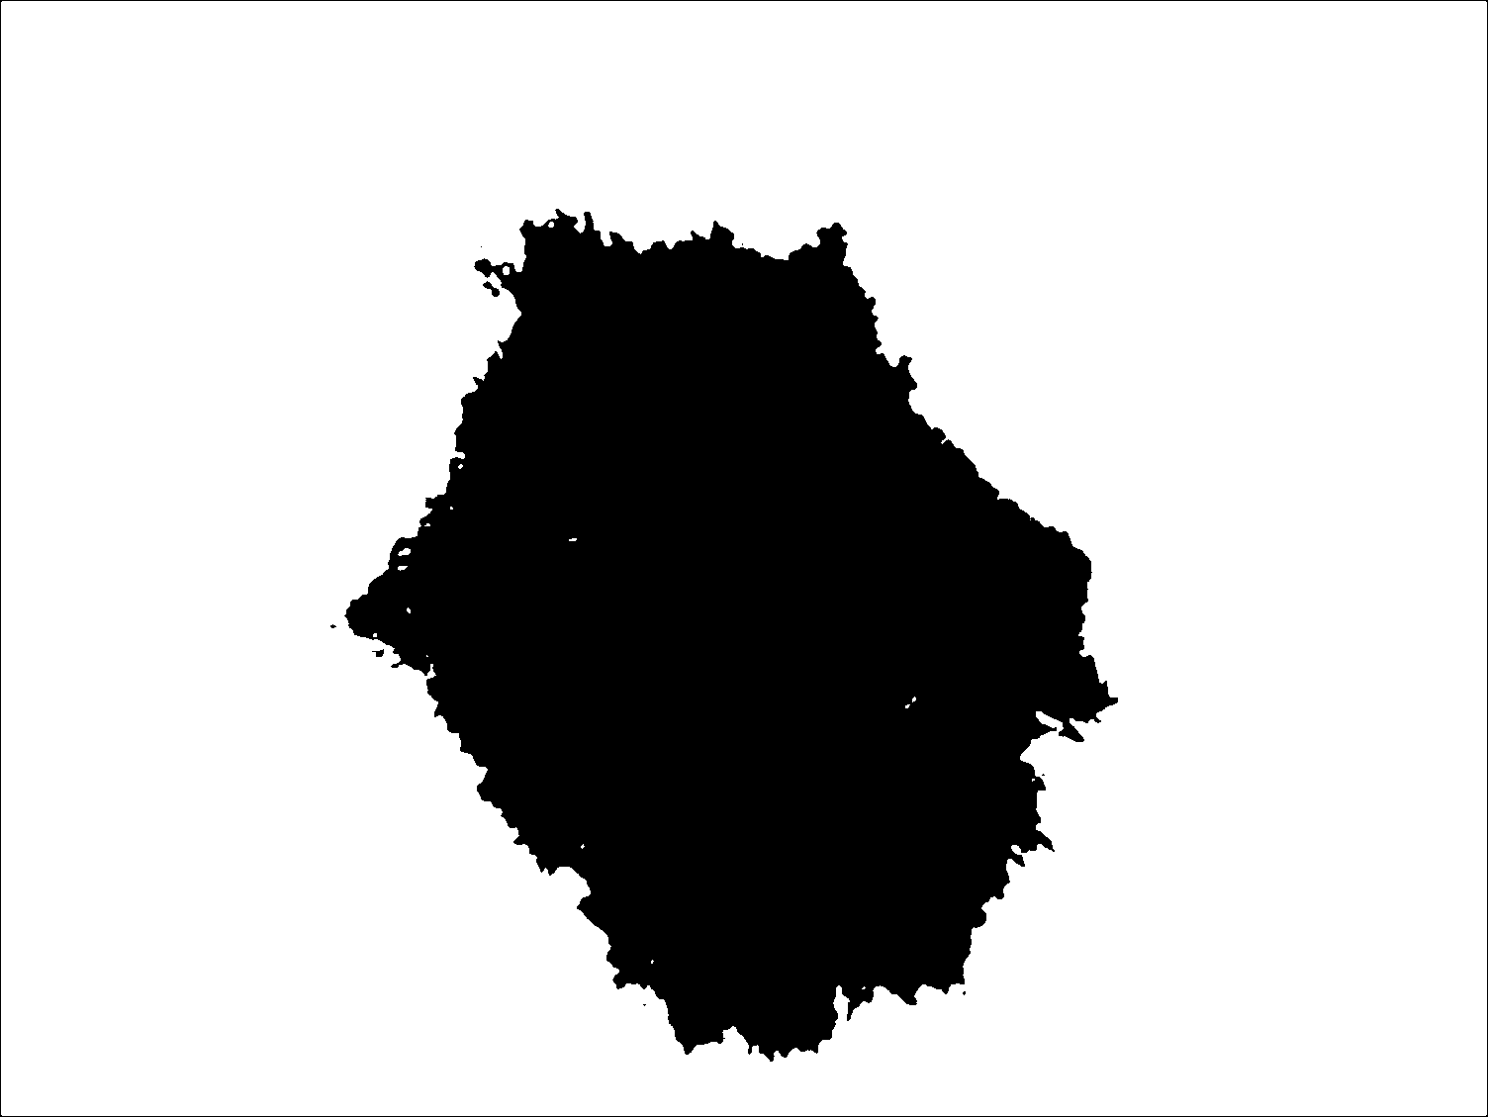
Algorithm Flow
Otsu’s Method
Opening & Closing
Channel Merging Logic
Output mask

Slide 11
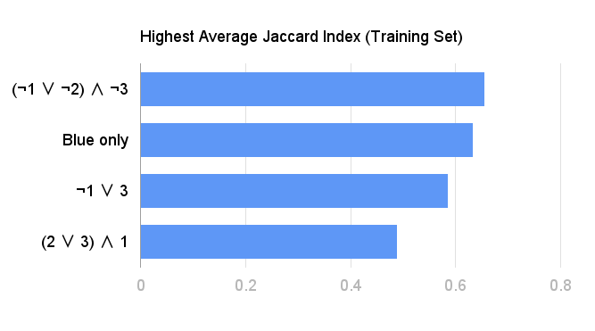
Analysis of Results
Highest average Jaccard index of each attempted channel merging logic during algorithm training

Slide 12
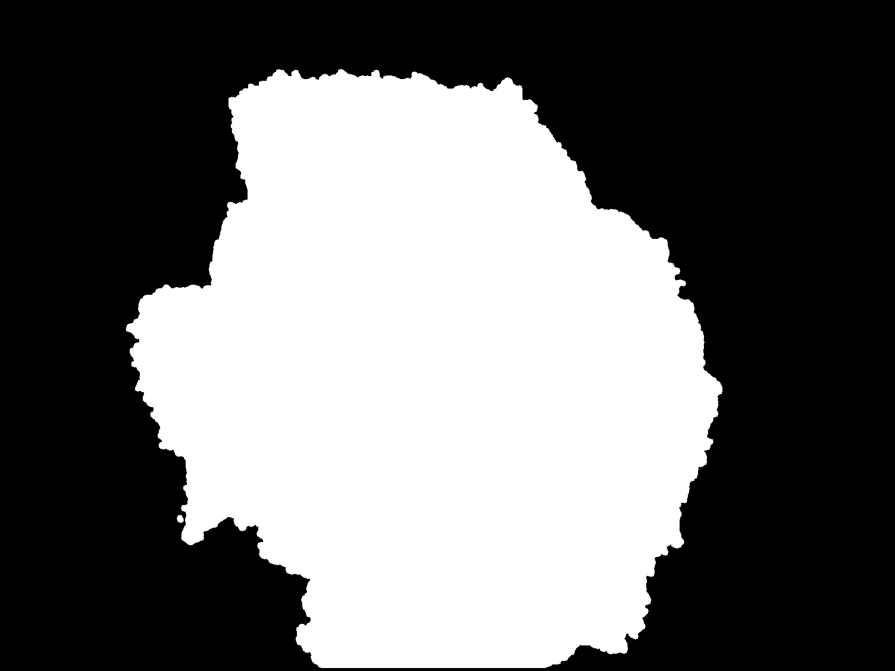
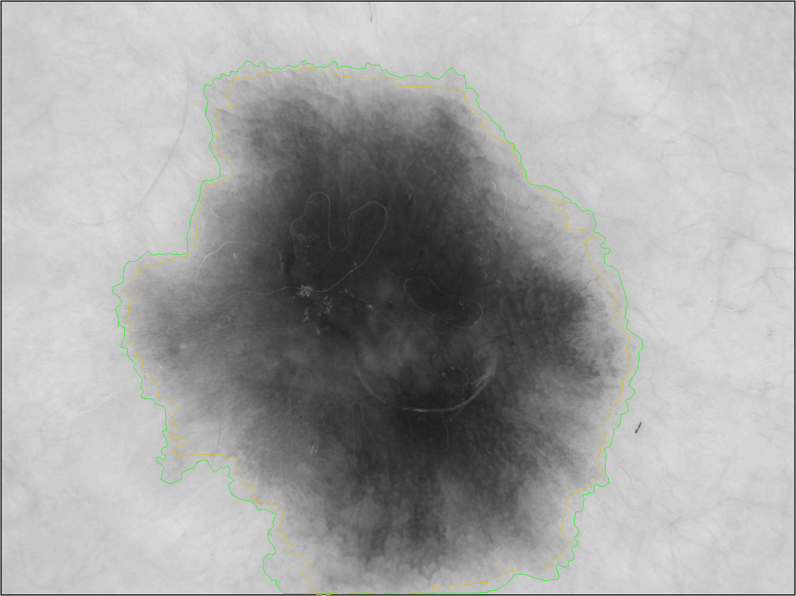
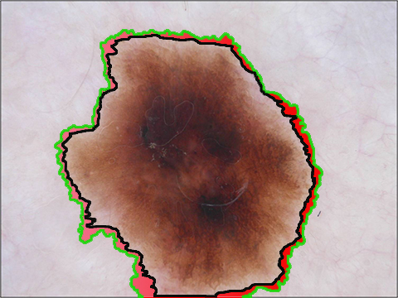
Discussion
What worked?
Images with fairly high contrast
Lower resolution images
Images that had fairly even color distributions
What didn’t work?
Images with low contrast
Higher resolution images
Images with high single color saturation
Jaccard Index = 0.918
Ground Truth
Overlay
(Green = Ground Truth, Black = Algorithm Output)
Algorithm Output

Slide 13
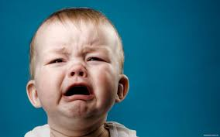
0.497
Our average Jaccard Index!!

Slide 14
Summary
Snake method is powerful, but less useful in higher resolution images
l*a*b color space enhances tumor features
Adaptive Thresholding provided an average Jaccard index of 0.497, and so we failed to accept our hypothesis
Future Scope
Combine merits of texture extraction and better segmentation from other 2 algorithms to proposed one.
Adjust filter parameters to adapt to image size
Use color space threshold to eliminate dermoscopic periphery
Consider using fixed luminance instead of individual color channels

Slide 15
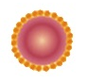
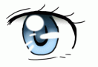
QUESTIONS
in our Vision?

